Slide 1

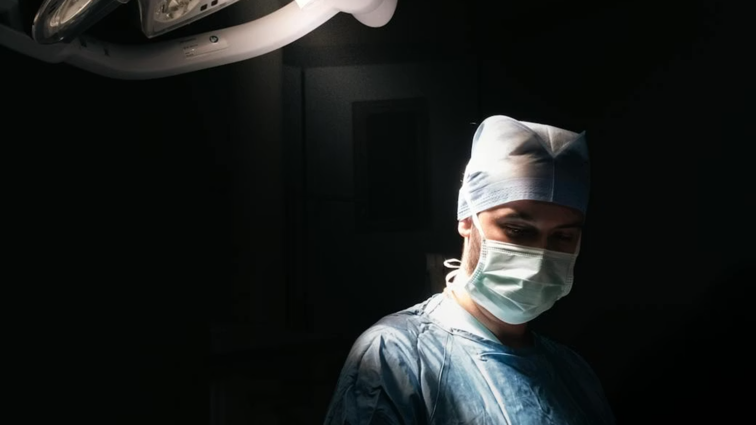
The Uncoached
Athlete
Performance Readiness and
The Surgical Profession
Rachel Neylan OLY · MSc · BAppScHuman Performance Consultant · Olympian · Physiotherapist
Notes:
1

Slide 2

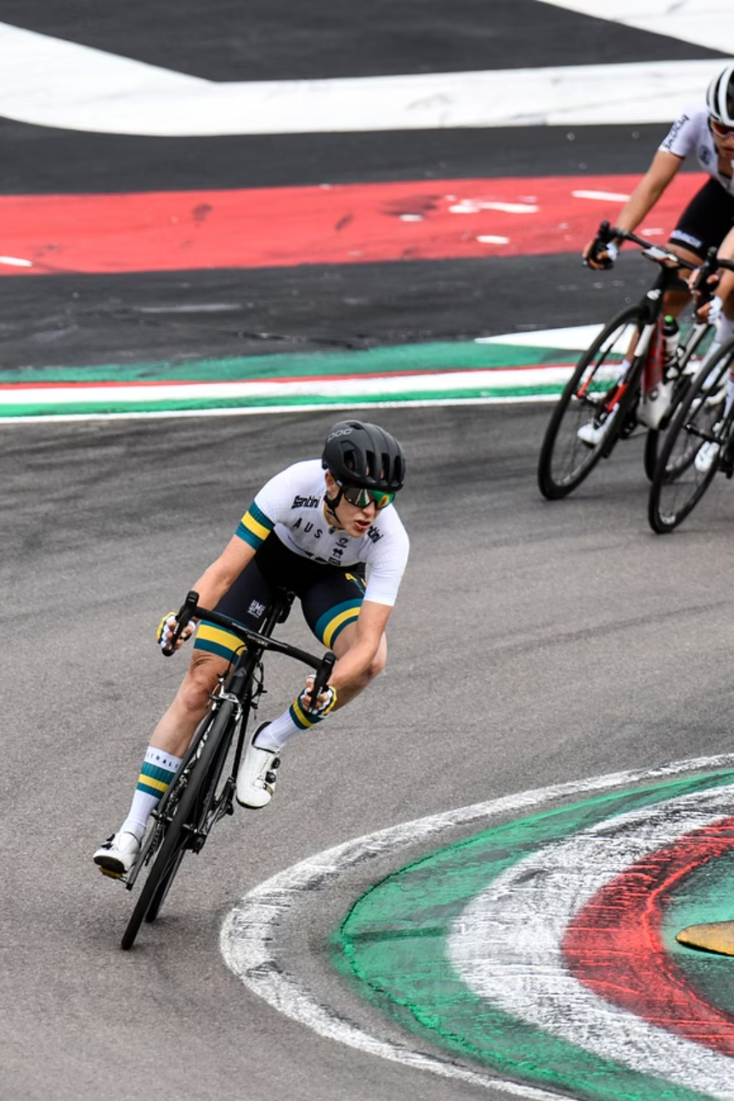
"At the Olympic Games, years of preparation come down to a single moment. Under pressure, at the limit of physical and mental capacity, with everything at stake. Surgeons live this every day. Except there is no podium. No offseason. No performance system behind them. Just the table, the patient, and everything they have."
— Rachel Neylan
Notes:
At the Olympic Games, years of preparation come down to a single moment. Under pressure. At the limit of physical and mental capacity. With everything at stake. Surgeons live this every day. Except there is no podium. No offseason. No performance system behind them. Just the table, the patient, and everything they have.
2

Slide 3
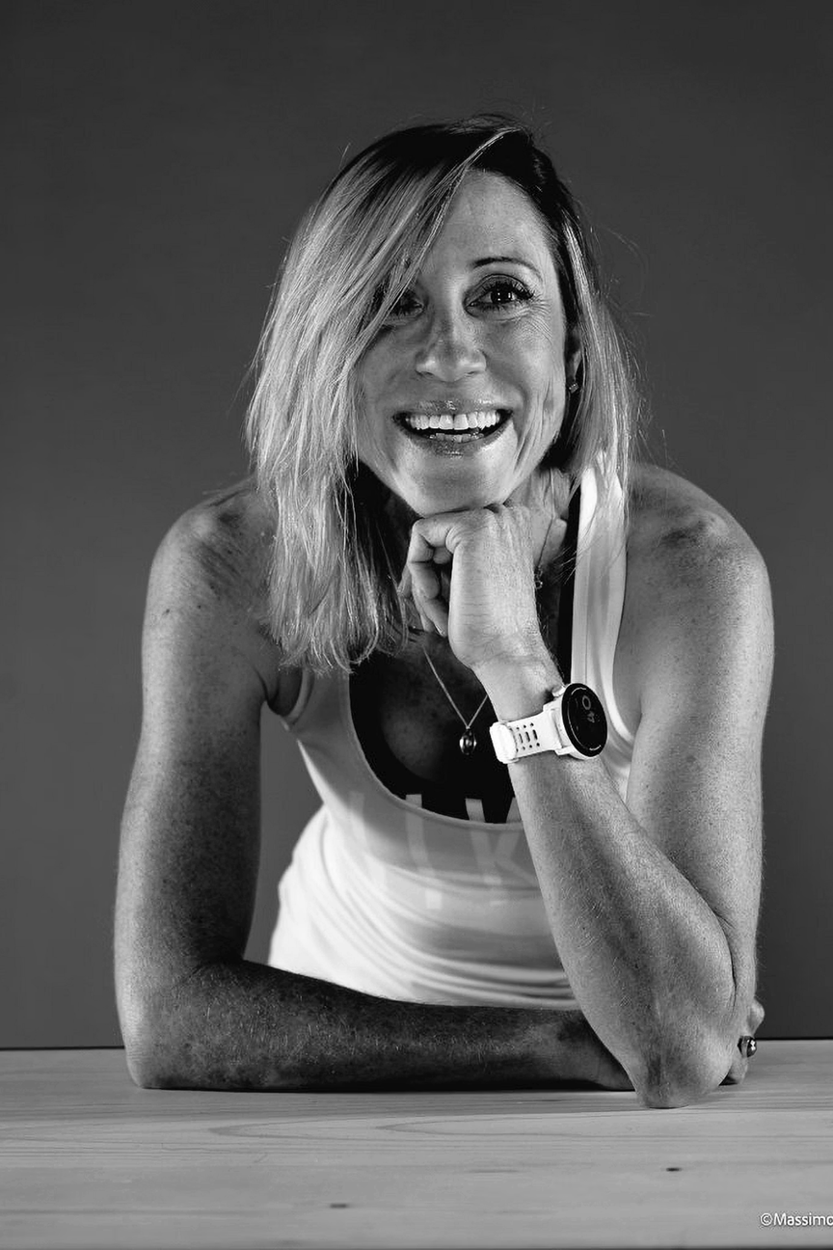

Rachel Neylan- Performance Consultant & Coach
Coaching Psychology
Applied Science
Performance Behaviour
Human Performance Strategy
Musculoskeletal Health / Physiotherapy
Elite Sport/ High Perfomance Science & Strategy
Physiotherapy
High Performance Sport
Coaching Psychology
BAppSc Applied Musculoskeletal science, Optimising human movement
Olympian, World Champ Medalist, Sustained high performance over 13 year pro cycling career
MSc in Coaching Psychology, Translating science + expertise into lasting behavioural change
Notes:
3

Slide 4

We have upgraded the tools. Not the surgeon.
Robotics
Navigation
Devices
Surgery has invested enormously in the instruments in the surgeon's hands. Almost nothing in the surgeon as a human performer.
The gap is system, culture, infrastructure, and that can change now.
Han et al. (2019) · Whelehan et al. (2021)
Notes:
4

Slide 5

The Paradigm Shift
FROM
TO
Endurance as identity
Self-sacrifice as professionalism
Fatigue as a badge of honour
Results as a byproduct of volume
Self-care as indulgence
Struggling in silence as strength
Recovery as weakness
Readiness as a standard
Performance as a managed system
Fatigue as a measurable variable
Deliberate practice over volume
Recovery as a clinical imperative
Coaching as infrastructure
Sustainability across a career
Excellence isn't what you endure, it is what you build.
Notes:
5

Slide 6
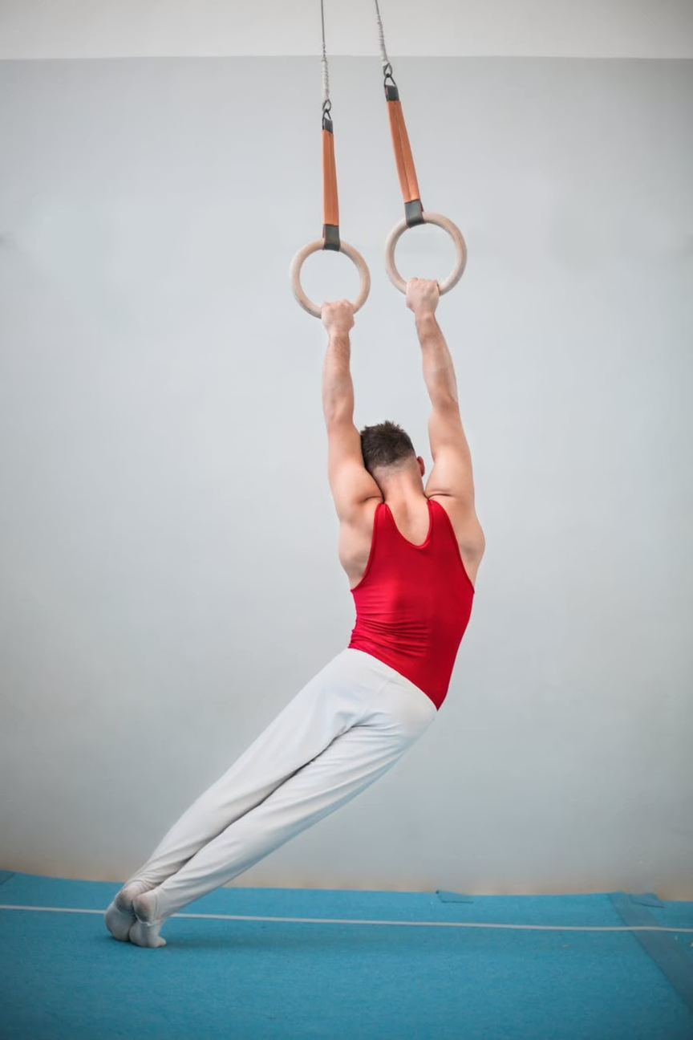
The Reality Check
F1 Driver
Fighter Pilot
Demands: Split-second decisions. Sustained precision. Physical/ cognitive peak under pressure.
Demands: Life-or-death decisions at speed. Sustained focus. Mission-critical execution.
System: Performance engineers. Physiologists. Psychologists. Biometrics. Simulation. Recovery.
System: Stress inoculation. Fatigue risk & crew resource management. Debrief protocols.
Navy SEAL
Olympic Athlete
Demands: Sustained high-risk, precision under extreme load. Team-critical decision-making.
Demands: Peak physical and cognitive output. Career-long performance. Outcomes that mater.
System: Physiological, cognitive, sleep, stress and recovery protocols. Team debriefs.
System: Coaches. Sports scientists. Nutritionists. Recovery specialists. Readiness tracking. Data.
The Surgeon
Demands: All of the above. Or greater. Stakes: a human life, not a podium. A career spanning three decades.
System: Evidence is clear, change is gaining traction, adoption needs to speed up.
They have it figured out - imagine if we built the same systems.
Notes:
6

Slide 7

The Performance Gaps
Stress and Arousal
Sleep and Fatigue
Problem: Surgeons are not trained to regulate.
Problem: Treated as a virtue. Debt accumulates faster than it resolves.
Opportunity: The optimal is findable, trainable, and measurable.
Opportunity: The most potent recovery lever.
Musculoskeletal Health
Recovery
Problem: High prevalence of injury, low ergonomic awareness.
Problem: Without structured recovery, each case begins more depleted than the last.
Opportunity: The same interventions protecting elite athletes are directly transferable.
Opportunity: Evidence-based protocols exist and are ready to implement today.
OR Environment
Well-being and Longevity
Problem: Noise, distractions, and flow disruptions directly impair performance and raise error rates.
Problem: A culture of extraction over sustainability.
Opportunity: A career-spanning performance system that redefines surgeon training, preparation, and workflow.
Opportunity: Every environmental variable is measurable and optimisable.
Torkamani-Azar et al. (2022) · Jevsevar et al. (2021) · Vasireddi et al. (2024) · Dupuy et al. (2018) · Kirksey et al. (2022) · Vitous et al. (2023)
Notes:
These are not unsolvable problems. They are mostly unaddressed ones.
7

Slide 8









Sustainable Performance
An integrated ecosystem, not case volume
Physical Conditioning
Recovery
MSK Health
Sleep and Fatigue
Stress
Environment
Team Culture
Cognitive Performance
Notes:
8

Slide 9

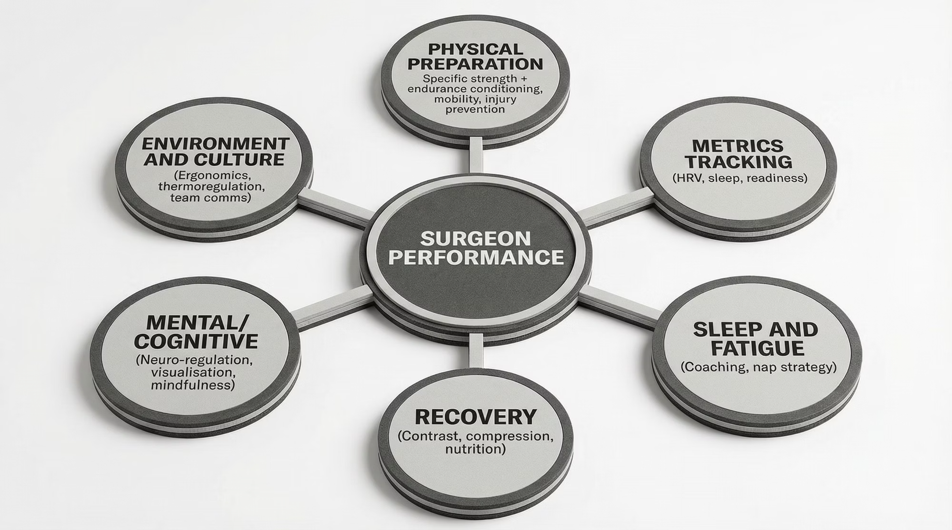

An Integrated System
Notes:
This exists in every high-performance domain. Except the OR.
9

Slide 10
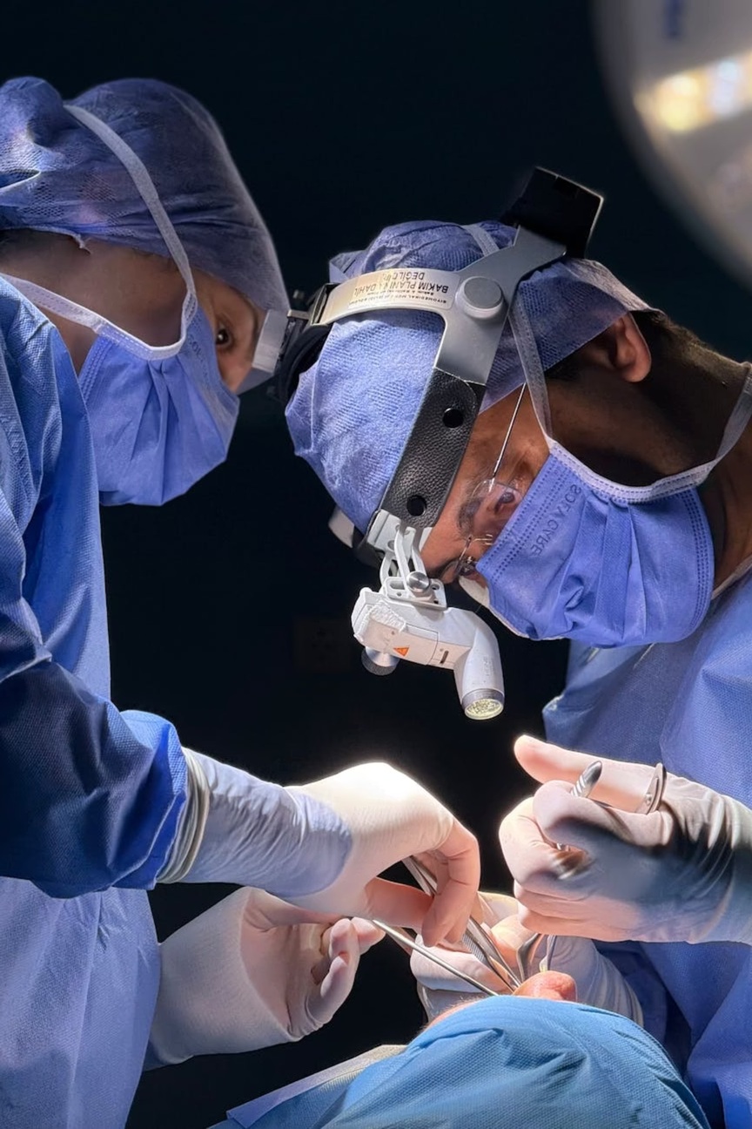



High Performance Requires a System
SYSTEMIC
Long-term frameworks that shift professional norms across an entire career, not a program. A paradigm.
INSTITUTIONAL
Workload design, ergonomic strategies, cultures that normalise physical /mental preparation & recovery
INDIVIDUAL
Exercise, sleep, hydration, recovery, stress regulation. Direct action to impact.
Vitous et al. (2023) · Minervini et al. (2025) · Hughes et al. (2023)
Notes:
The European Society of Thoracic Surgery already calls their well-being programme Fit2Perform. The framing is arriving. Athletes do not do programmes. They build systems.
10

Slide 11
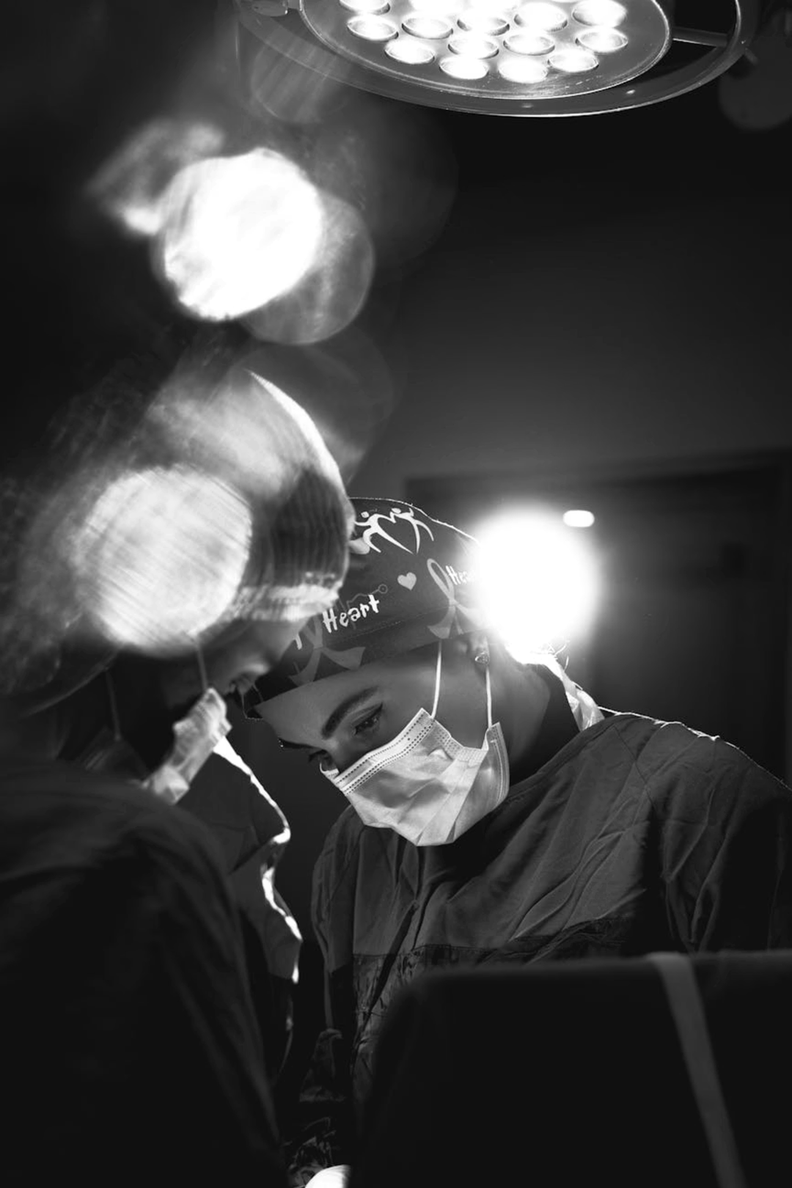
Shifting the Paradigm
You were trained to withstand. You deserve to be supported. Action points:
For yourself
Choose one recovery input. Track it as training data, not self-indulgence.
For your team
Name one OR environment variable you can change. Make the invisible visible.
For your institution
Ask for the infrastructure by name. Coaching. Monitoring. Ergonomic support.
Notes:
"I stood on Olympic start lines for fourteen years. The answer was never to push harder through it. It was to build systems around it. The most prepared athlete in the room is never the one who trained hardest. It is the one who trained most deliberately and recovered most completely. You deserve the same infrastructure. So do your patients."
— Rachel Neylan
It exists in every high-performance domain — time to say it belongs in surgery.
11

Slide 12
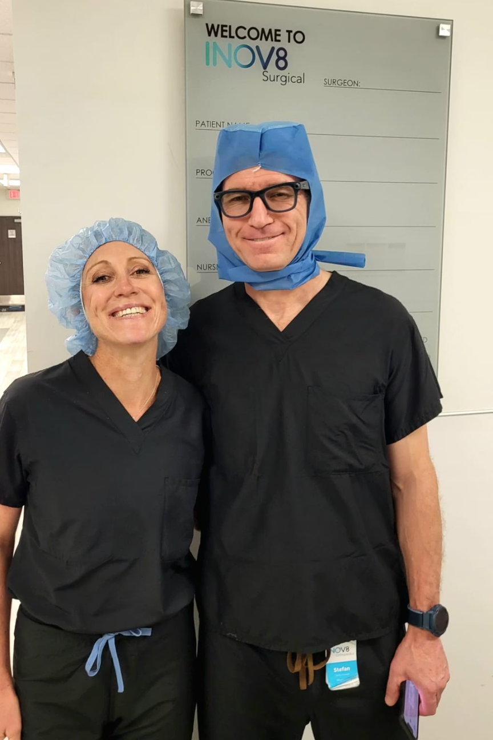


The Surgeon's Voice
"When I started treating my preparation and recovery with the same seriousness as my technical training, I noticed an immediate difference in focus, endurance, and decision-making. Human performance science is the missing link in surgery."
— Dr Stefan Kreuzer
"For years we have optimised instruments, workflows, and operating theatres, but not ourselves. This approach reframes the surgeon as a high performer and it is exactly the mindset shift our profession needs."
— Prof Bill Walter
"Every surgeon in this room already performs like an elite athlete. They just have not been supported like one"
— Dr Jit Balakumar
Notes:
those already experiencing the shift - are saying it
12

Slide 13

"The most advanced tool in the OR will always be the surgeon."
— Rachel Neylan
Notes:
13

Slide 14

Thank You
Rachel Neylan (OLY, MSc, BAppSc)
Human Performance Consultant · Olympian · Physiotherapist
Website
www.rachelneylan.com
Email
rachel@rachelneylan.com
Notes:
14

